Slide 1

File Handling in Python

Slide 2
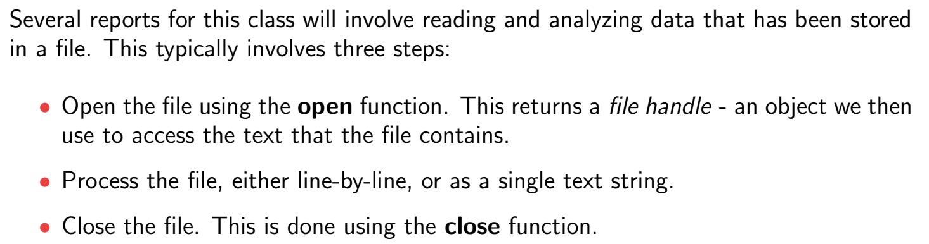
Reading & Writing Files

Slide 3
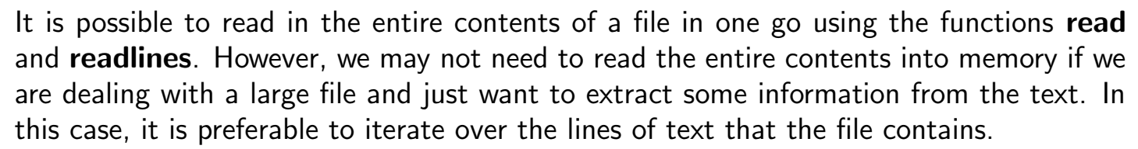
Reading & Writing Files

Slide 4
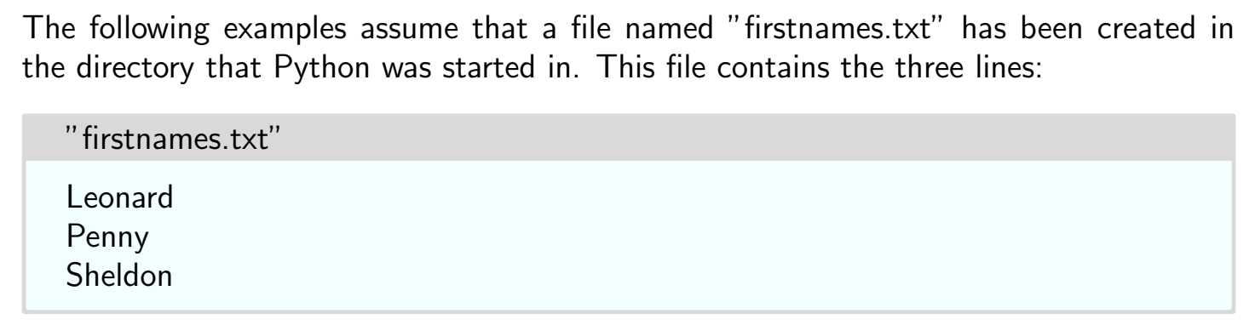
Reading & Writing Files

Slide 5
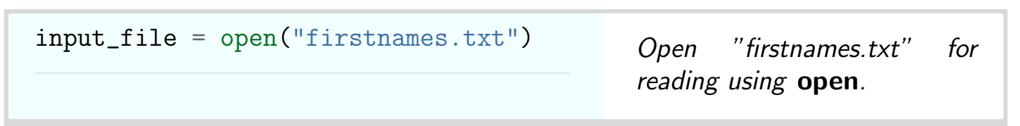
Opening a File

Slide 6
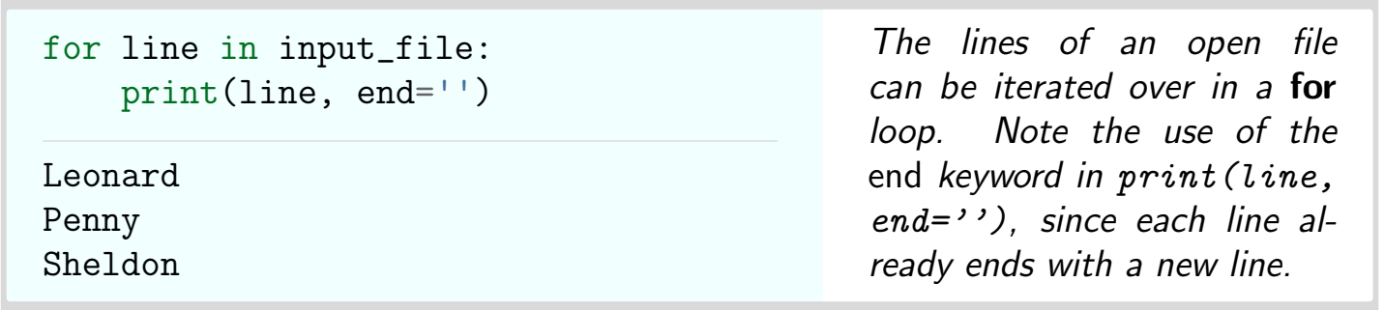
Using for loop

Slide 7
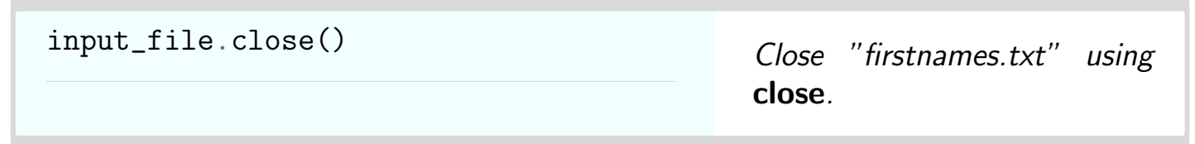
Closing a file

Slide 8
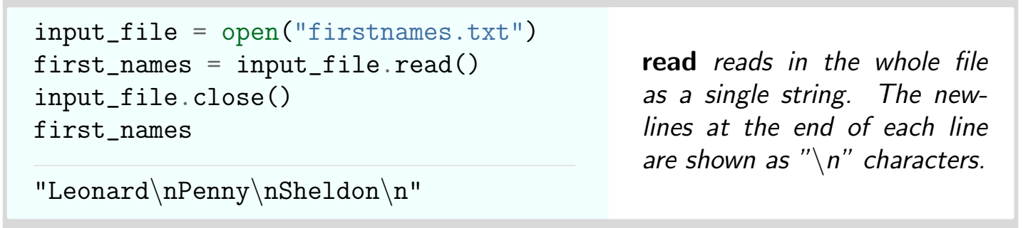
Read( )

Slide 9
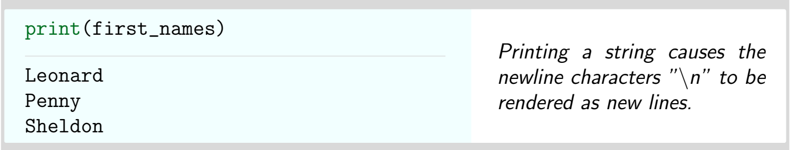
Displaying

Slide 10
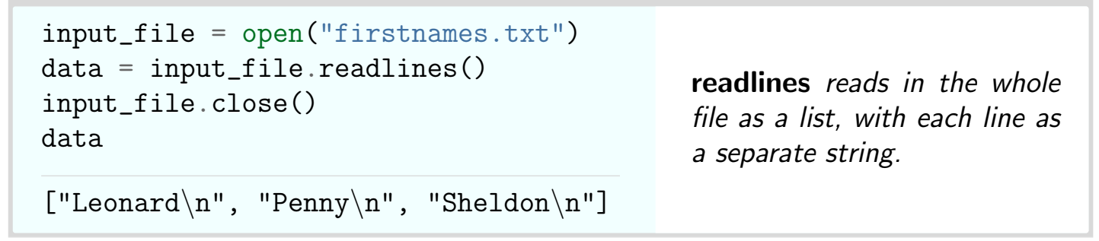
readlines( )

Slide 11
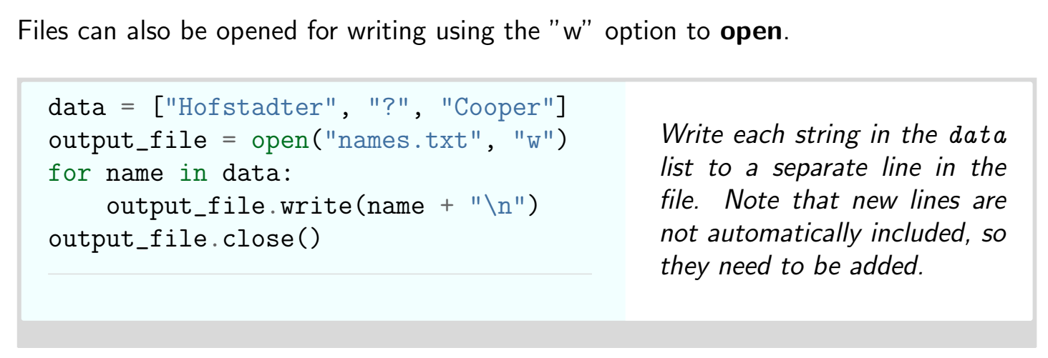
Opening a File for Writing

Slide 12
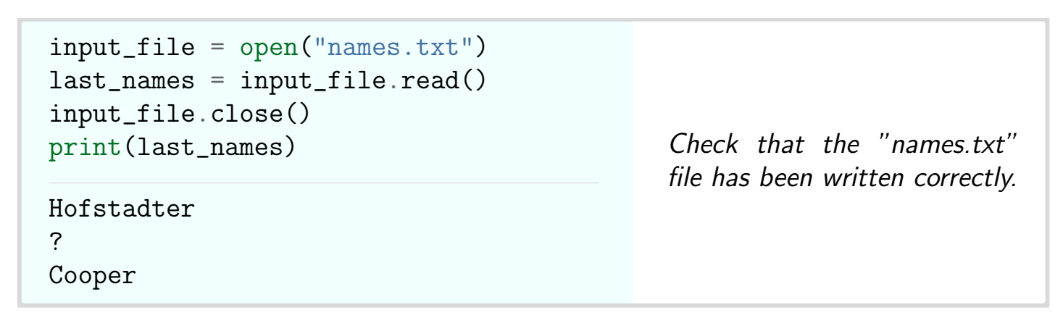
Reading the same file

Slide 13
Thank You

